Slide 1
Classification of Electroencephalogram (EEG) data with Neural Nets and CNN Supervisor : Doç.Dr. SELÇUK KIRAN
WIFO-PROJEKT
Özgürazad Çelik - 138417056

Slide 2
Contents
Structure of Human Brain
Electroencephalography(EEG)
Types of Brainwaves
Brain-Computer Interface (BCI)
Components of a BCI system
ANN
CNN
EEG data classification with ANN and CNN
Conclusion
References

Slide 3


Neurons

Slide 4
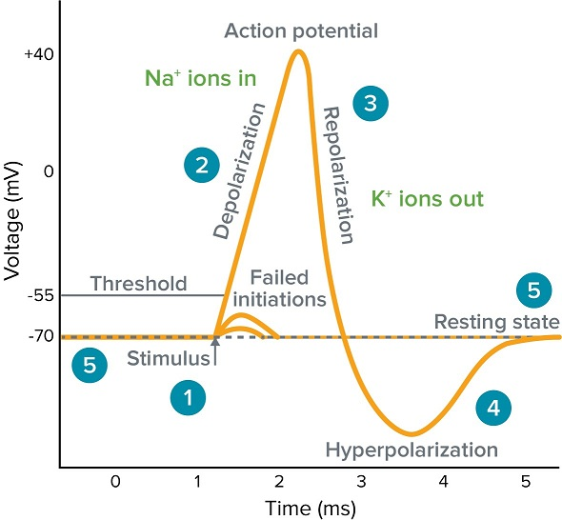
Action Potential

Slide 5
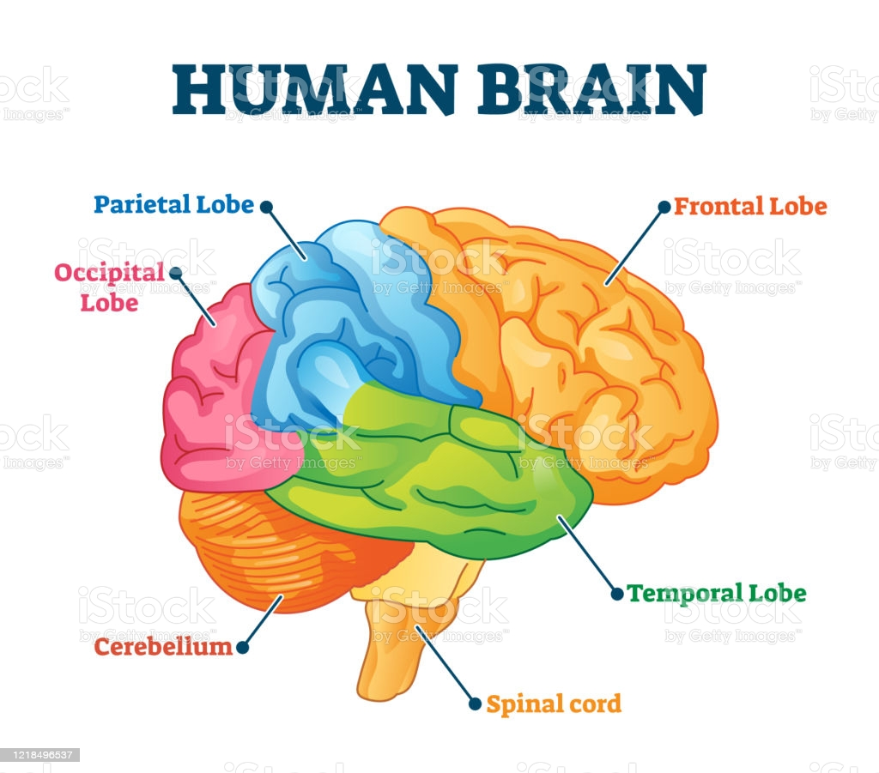
Anatomy of the Brain

Slide 6
What is an EEG?
An EEG test evaluates the electrical activity of the brain. EEG scans are performed by placing EEG sensors – small metal discs also called EEG electrodes – on our scalp. These electrodes pick up and record the electrical activity in our brain. The collected EEG signals are amplified, digitized, and then sent to a computer or mobile device for storage and data processing.
Analyzing EEG data is an exceptional way to study cognitive processes: It can help doctors establish a medical diagnosis, researchers understand the brain processes that underlie human behavior, and individuals to improve their productivity and wellness.

Slide 7
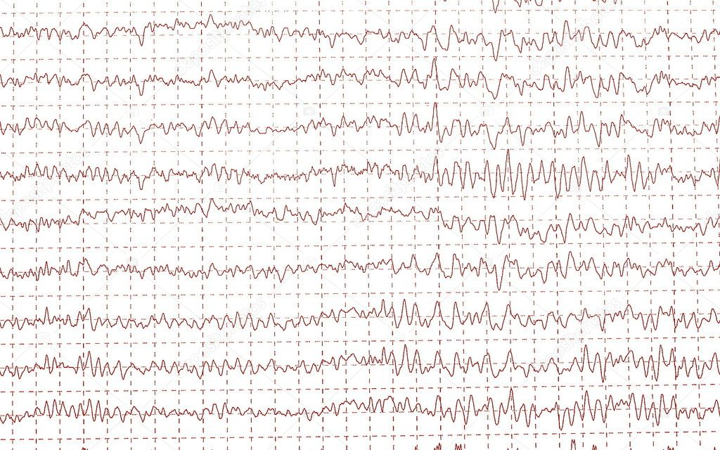

Slide 8
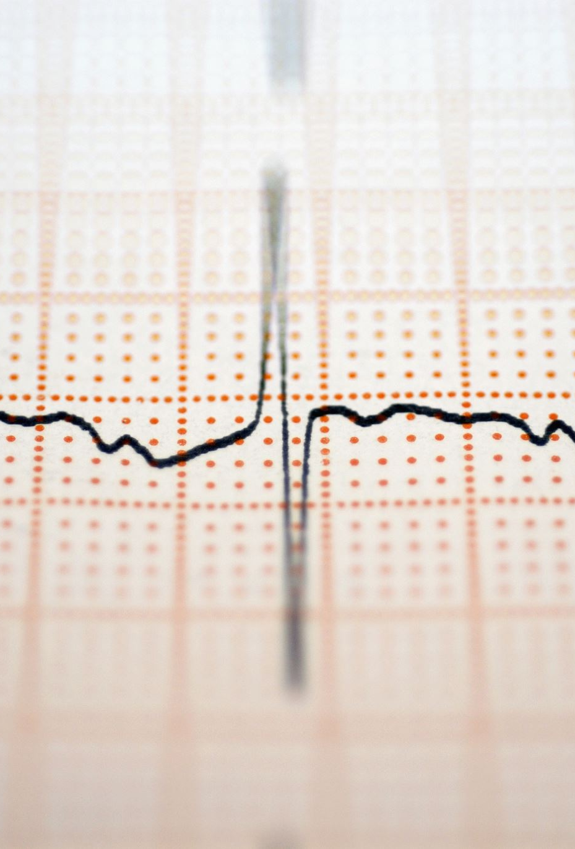
Types of Brainwaves that EEG Measures
The electrodes of an EEG device capture electrical activity expressed in various EEG frequencies. Using an algorithm called a Fast Fourier Transform (FFT), these raw EEG signals can be identified as distinct waves with different frequencies. Frequency, which refers to the speed of the electrical oscillations, is measured in cycles per second—one Hertz (Hz) is equal to one cycle per second. Brainwaves are categorized by frequency into four main types: Beta, Alpha, Theta and Delta.

Slide 9

Delta Waves (δ, 0.5-4Hz)
Delta activity is predominantly found in infants. Delta waves are associated with deep stages of sleep in older subjects.
Delta waves are characterized by low-frequency (about 3 Hz), high amplitude waves. Delta rhythms can be present during wakefulness—they are responsive to eye-opening and may be enhanced by hyperventilation as well. When measured by an EEG device, these are often referred to as EEG delta waves.

Slide 10
Theta Waves (θ, 4-8Hz)
Brain activity within a frequency range comprised between 4 and 7 Hz is referred to as Theta activity. Theta rhythm detected in EEG measurement is often found in young adults, particularly over the temporal regions and during hyperventilation. In older individuals, theta activity with an amplitude greater than about 30 millivolts (mV) is seen less commonly.

Slide 11
Alpha Waves (α, 8-13Hz)
Alpha waves are often associated with a relaxed, calm and lucid state of mind. Alpha waves can be found in the occipital and posterior regions of the brain. Alpha waves can be induced by closing one’s eyes and relaxing, and they are rarely present during intense cognitive processes like thinking, mental calculus and problem-solving. In most adults, alpha waves range in frequency from 9 to 11 Hz. When measured by an EEG device, these are often referred to as EEG alpha waves.

Slide 12
Beta Waves (β, 13-30Hz)
Beta waves are most closely associated with being conscious or in an awake, attentive and alert state. Low-amplitude beta waves are associated with active concentration, or with a busy or anxious state of mind. Beta waves are also associated with motor decisions (suppression of movement and sensory feedback of motion). When measured by an EEG device, the signals are often referred to as EEG beta waves.

Slide 13
Gamma Waves (γ, >30Hz):
The occurrence of the gamma waves is rare and they have been used to detect specific diseases. The region of these waves cover frontocentral area on the brain.

Slide 14
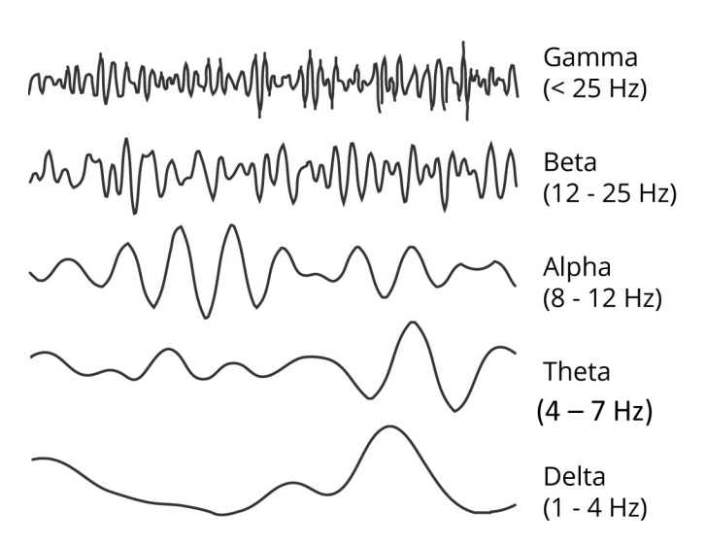
Waveforms

Slide 15
Brain-Computer Interface (BCI)
Devices that enable its users to interact with computers by mean of brain-activity only, this activity being generally measured by ElectroEncephaloGraphy (EEG).

Slide 16
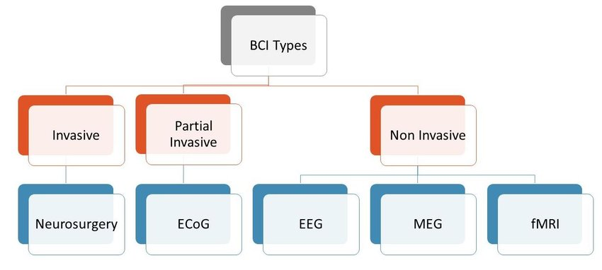
Types of BCI
Brain computer interfaces can be classified in three main groups:

Slide 17
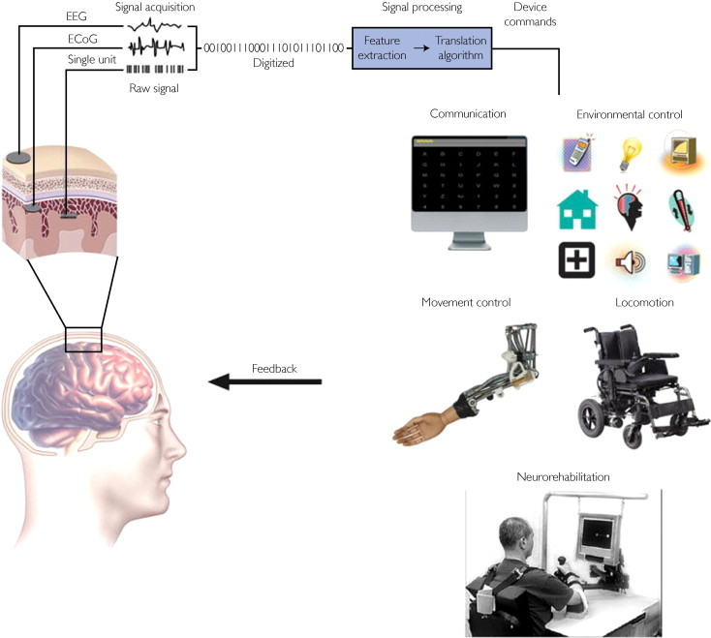
Electrical signals from brain activity are detected by recording electrodes located on the scalp, on the cortical surface, or within the brain. The brain signals are amplified and digitized. Pertinent signal characteristics are extracted and then translated into commands that control an output device, such as a spelling program, a motorized wheelchair, or a prosthetic limb. Feedback from the device enables the user to modify the brain signals in order to maintain effective device performance.
Components of a BCI system

Slide 18
Signal acquisition
Signal acquisition is the measurement of brain signals using a particular sensor modality (eg, scalp or intracranial electrodes for electrophysiologic activity, fMRI for metabolic activity). The signals are amplified to levels suitable for electronic processing (and they may also be subjected to filtering to remove electrical noise or other undesirable signal characteristics, such as 60-Hz power line interference). The signals are then digitized and transmitted to a computer.

Slide 19
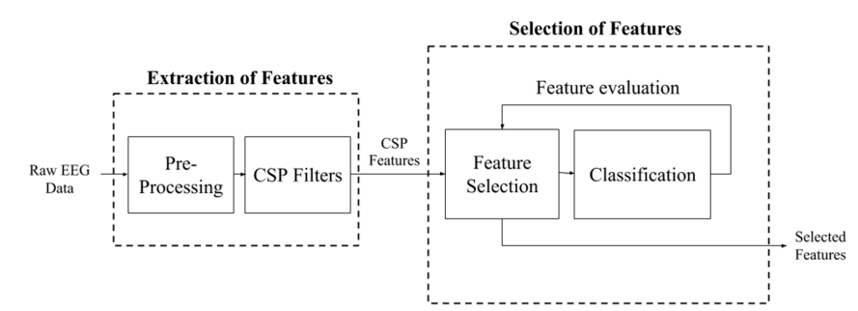
Extraction and Selection

Slide 20
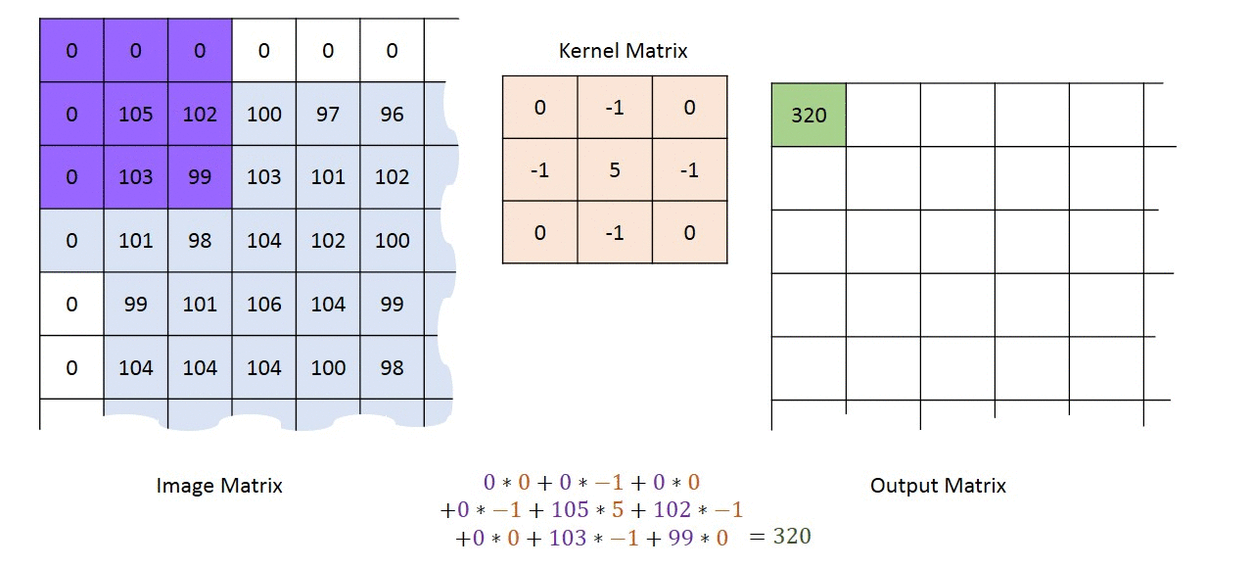
Feature Extraction
Feature extraction works around the idea of extracting useful features that clearly identify objects in an image.
It involves reducing the number of resources required to describe a large dataset, it is dimension reduction.

Slide 21
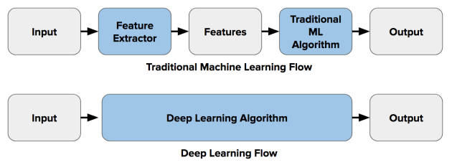
Feature Extraction
Why we use Feature Extraction
Performing analysis with a large number of variables often requires large amounts of memory and computational power
Too many features can increase the complexity of our model, leading to an overfit.
Feature extraction; It defines the data with sufficient accuracy and uses different types of filters to transform it with the image to overcome these problems.

Slide 22
Feature Translation
The resulting signal features are then passed to the feature translation algorithm, which converts the features into the appropriate commands for the output device (ie, commands that accomplish the user's intent). For example, a power decrease in a given frequency band could be translated into an upward displacement of a computer cursor, or a P300 potential could be translated into selection of the letter that evoked it. The translation algorithm should be dynamic to accommodate and adapt to spontaneous or learned changes in the signal features and to ensure that the user's possible range of feature values covers the full range of device control.

Slide 23
Device Output
The commands from the feature translation algorithm operate the external device, providing functions such as letter selection, cursor control, robotic arm operation, and so forth. The device operation provides feedback to the user, thus closing the control loop.

Slide 24
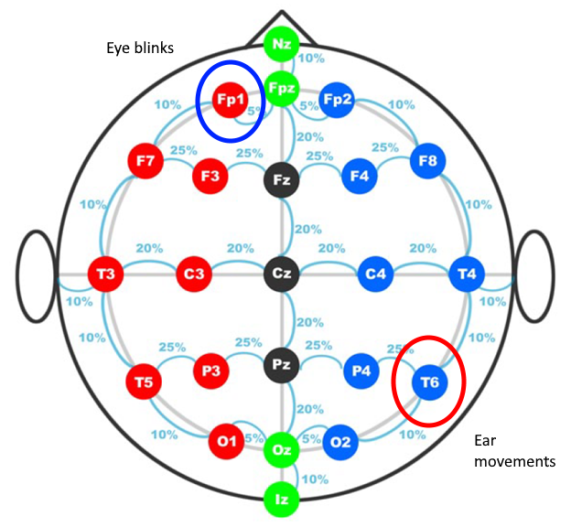
BCI Eletrodes

Slide 25

Artificial Neural Networks
Neural networks are information processing systems with interconnected neurons. Using certain algorithms they can recognize, cluster, and classify hidden patterns and correlations in raw data and continually learn and improve – over time.

Slide 26
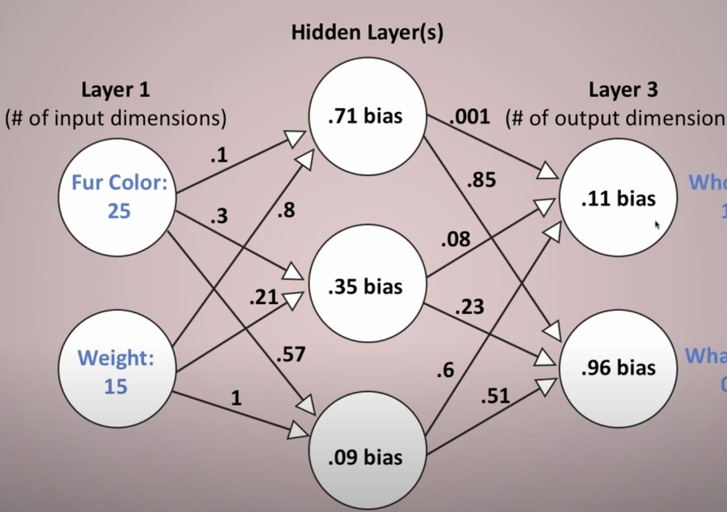
Forward Propagation
Our input data is given to artificial neural networks. The weight values in our artificial neural network in our neurons are given randomly.
The data in the input neuron is sent to the next neuron with the weight values.
Each neuron multiplies and sums the values and weights of the neurons connected to it. This result is being given as input into the activation function.

Slide 27
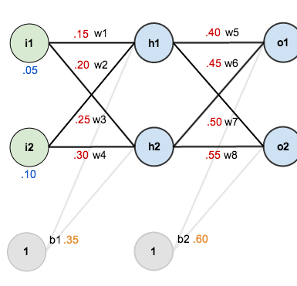
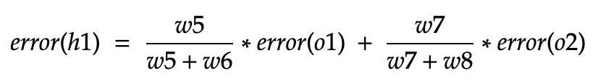
Back Propagation
The prediction results from the neurons in the output layer are compared with the real value and the error is calculated. Using these error values and the weight values of the previous layer, the error of the previous layer is calculated.
Gradients are calculated using the calculated error values. Weight values are recalculated using these gradients.

Slide 28
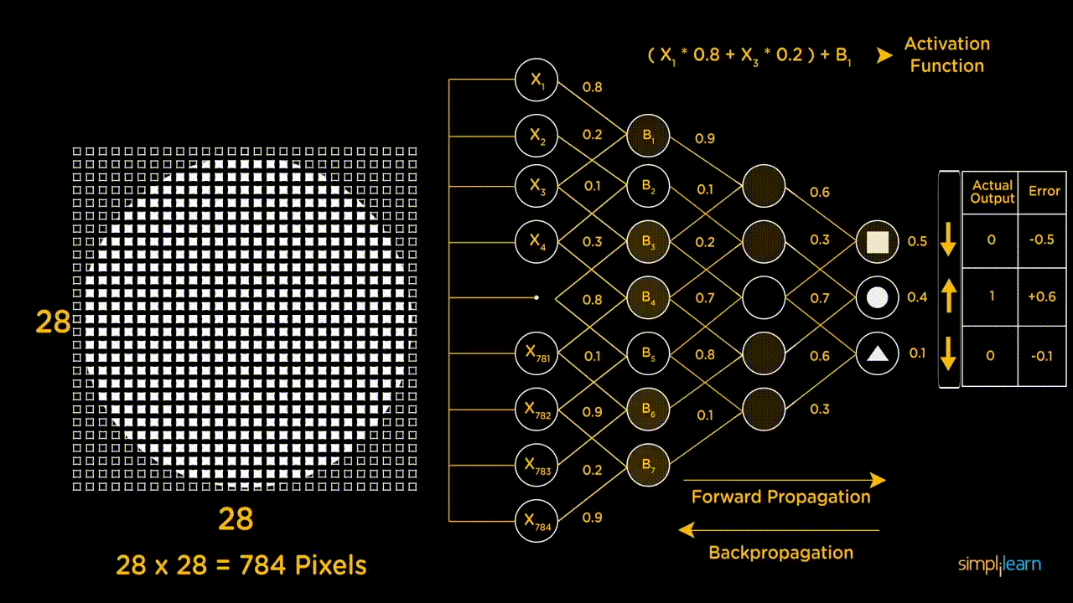

Slide 29
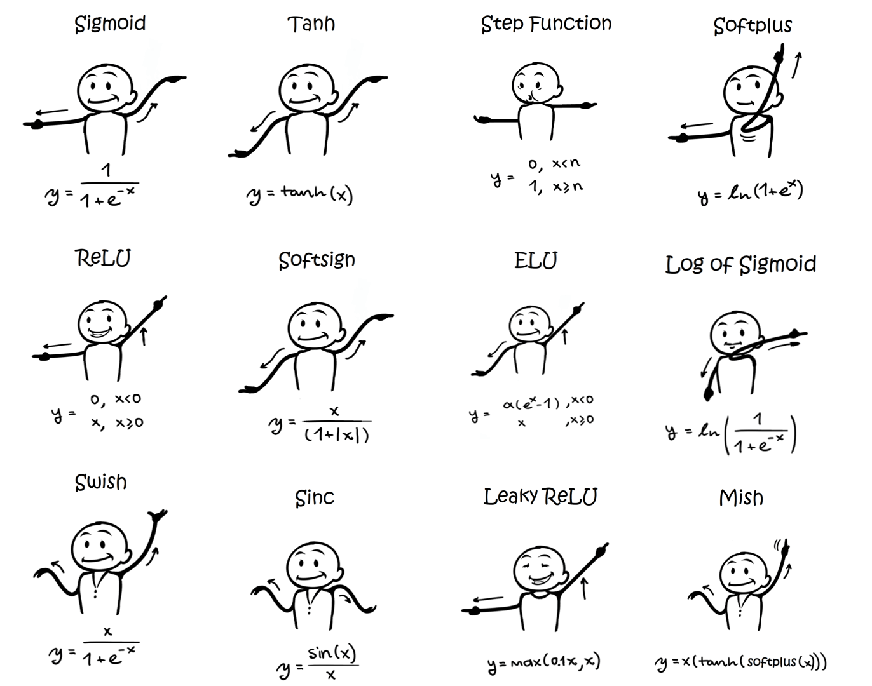
What ıs Actıvatıon Functıon?
The activation function, in its simplest form, is the function that decides how a linear function calculated using the inputs of a neuron will exit the neuron.
It is used to distort the linearity and determines how the linearity will be distorted.
A classical neuron does not have an activation function unless given manually and performs a linear computation.

Slide 30

Convolutional Neural Network (CNNs)

Slide 31
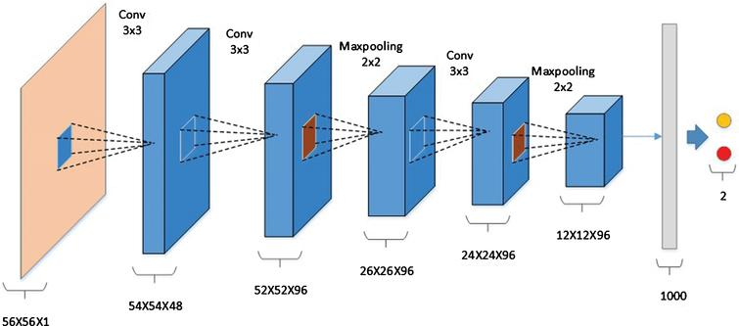
CNN and Layers
CNN layers;
Convolutional Layer
Pooling
(Downsampling Layer)
Stride
Padding
Flattening Layer
Fully-Connected Layer

Slide 32
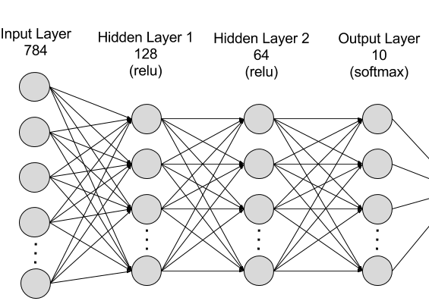
Input Layer
The input layer in CNN should contain the image data. Image data is represented by a multidimensional matrix and reshaped into a single vector within the input layer.
For example, you have a 28x28 image. This image is converted into a 784x1 vector as 28x28=784 before processing.

Slide 33

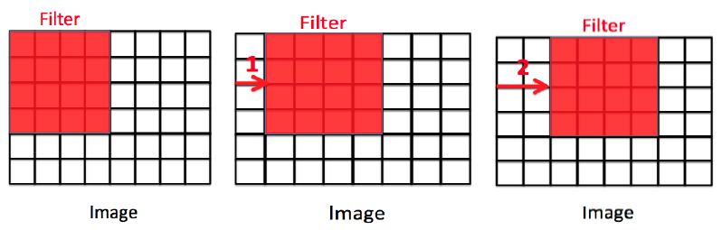
Stride
We express the number of rows and columns covered per shift as stride.
The number of stride does not have to be one. Sometimes, either for computational efficiency or because we want to downsample, we move our window multiple items at once, bypassing intermediate positions.

Slide 34
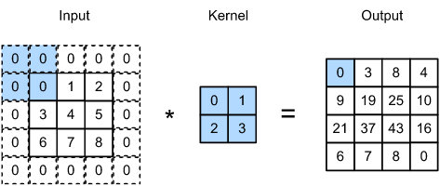
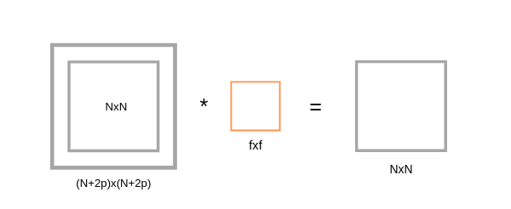
Padding
One problem with applying convolutional layers is that we tend to lose pixels around our image.
Especially when we apply many sequential convolution layers, pixel losses can be experienced intensely.
A simple solution to this problem is to add extra padding pixels around the border of our input image, thus increasing the effective size of the image.

Slide 35
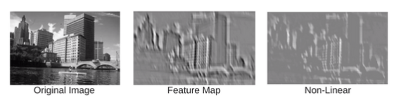
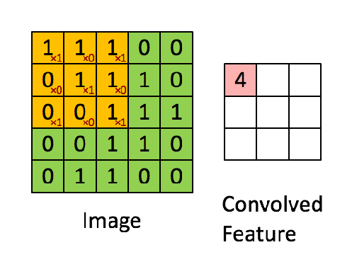
Convolution Layer
The convolution layer (CONV) uses filters that perform convolution operations while scanning the input layer by size.
The resulting output is called the feature map or activation map.

Slide 36
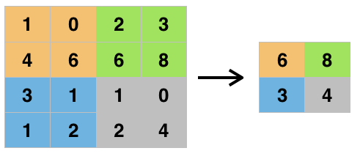
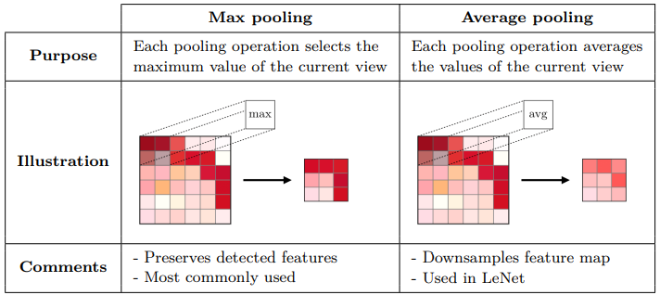
Pooling Layer
It is used to reduce the size of feature maps. Thus, it reduces the number of parameters to be learned in the network and the amount of calculations made.

Slide 37

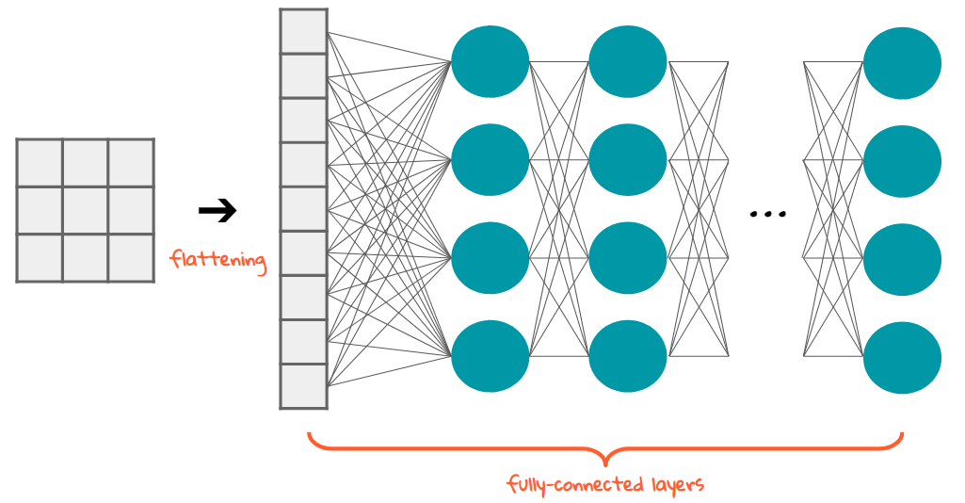
Flattenıng Layer
Once the Feature Map is obtained, the next step is to flatten it.
Flattening involves converting the entire pooled feature map matrix into a single column and feeding the neural network for further processing

Slide 38
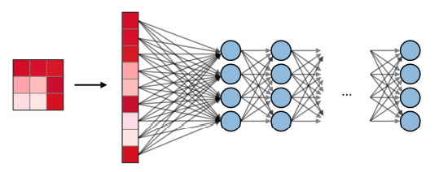
Fully Connected Layer
A fully connected layer (FC) is a layer where all inputs in one layer are connected to each unit of the next layer. It is a standard neural network layer.
Fully connected layers can be used to optimize goals such as class scores.
The biggest advantage of fully connected layers is; They are structure independent. No special assumptions to be made about the input

Slide 39
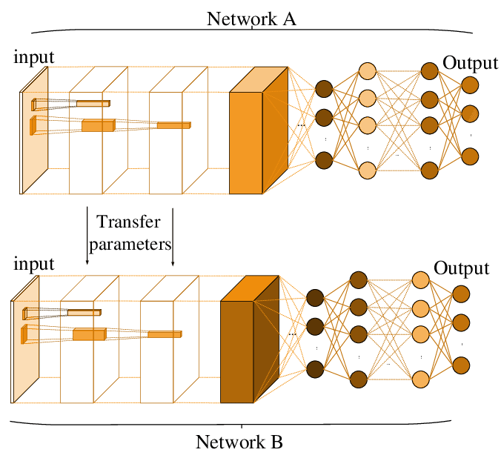
What is a Pre-Trained Model
A pre-trained model is a registered network that has been previously trained on a large dataset, typically a large-scale image classification task. You either use the pre-trained model as is, or you use transfer learning to customize this model for a specific task.
xception
Inception V3
ResNet50
VGG16
VGG19
MobileNet

Slide 40
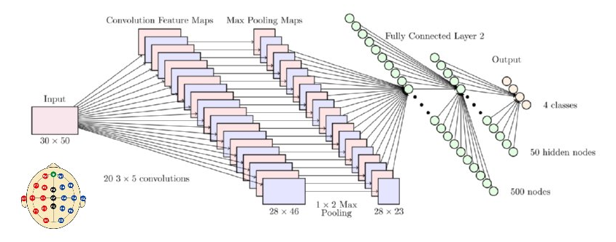
Convolutional Neural Network and BCI
One advantage of using deep learning technique is that it requires minimal pre-processing since optimal settings are learned automatically. Regarding CNNs, feature extraction and classification are integrated into a single structure and optimized automatically. Moreover, fNIRS time series data of human subjects were input to the CNN. As the convolution is performed in the sliding show manner, the feature extraction process of CNN retains the temporal information of the time series data obtained by fNIRS.

Slide 41
EEG data classification with ANN and CNN
In this study, at the first a total of 16 EEG data from 8 subjects and then 40 EEG data from 20 subjects were classified with ANN and CNN.
There are 2 classes in the study.
First class corresponds to motor reaction of opened eyes
Second one corresponds to motor reaction of closed eyes

Slide 42
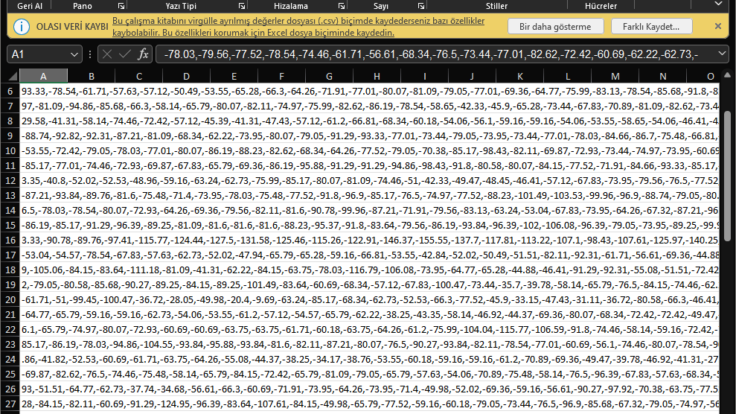
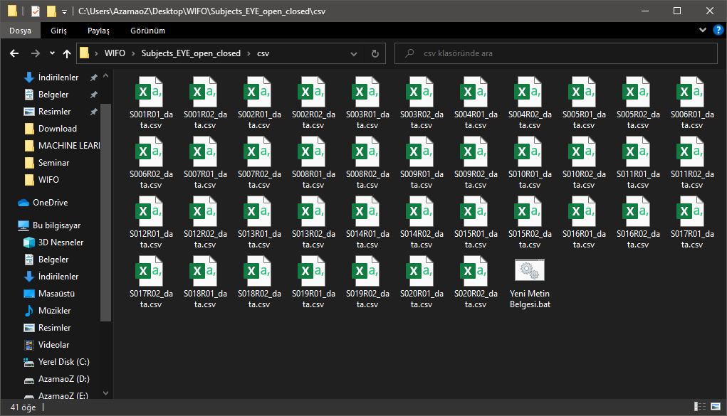
EEG data classification with CNN

Slide 43
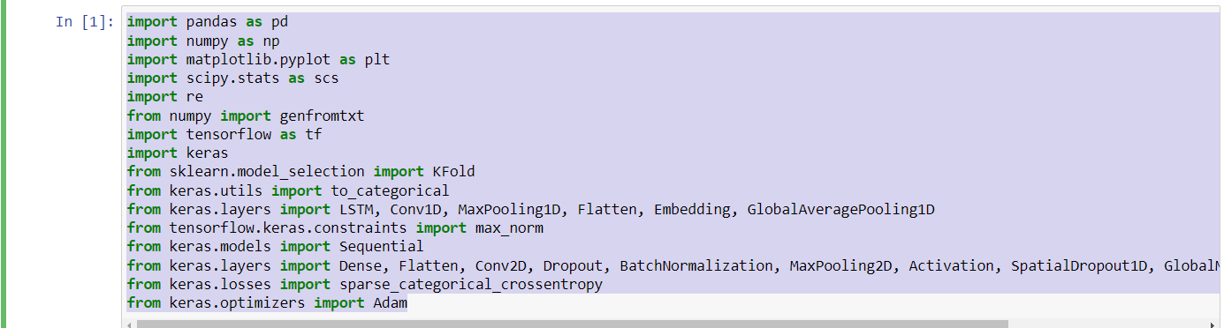
Loading Libraries

Slide 44
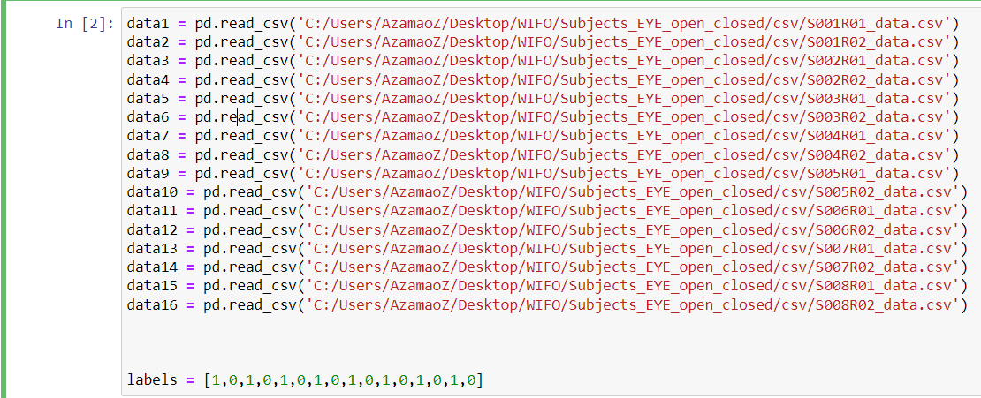
Data Import

Slide 45
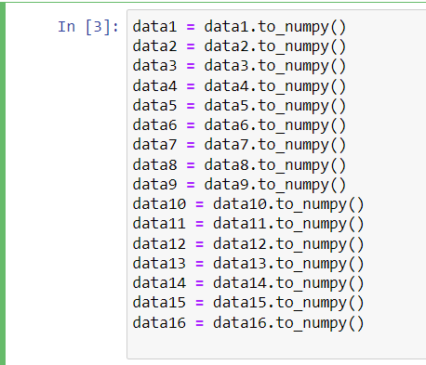
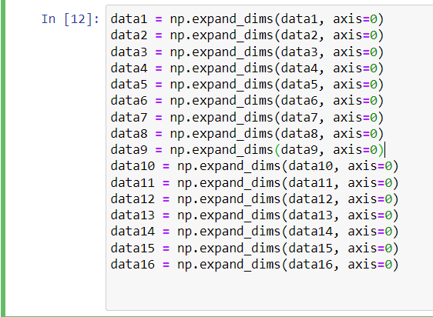
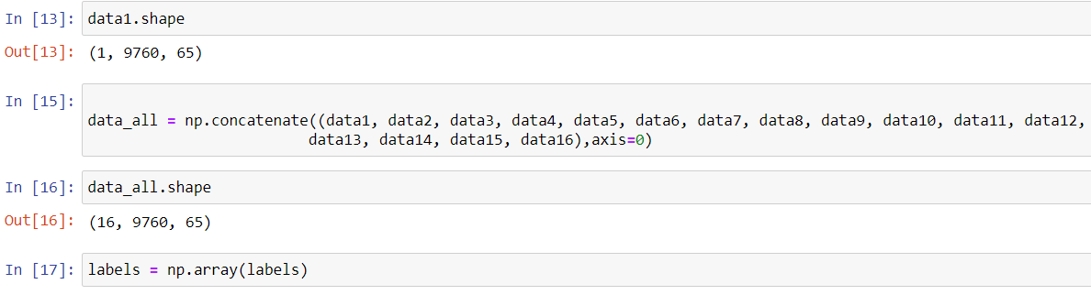
Organizing data

Slide 46
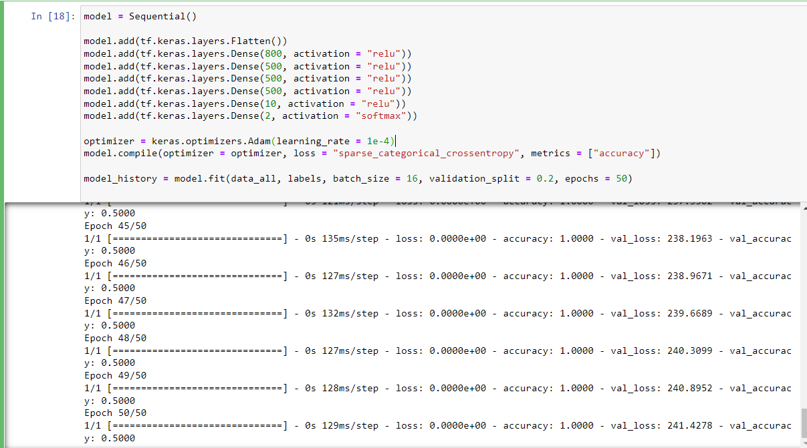
ANN

Slide 47
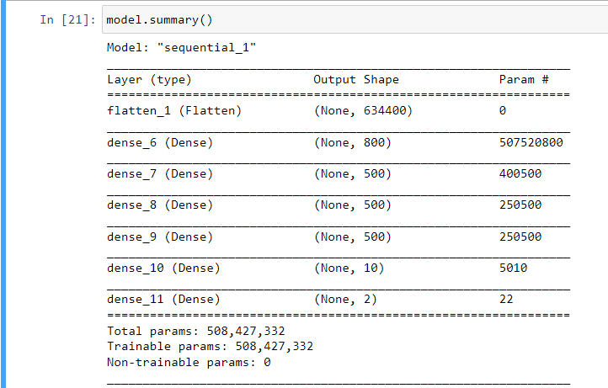
ANN Summary

Slide 48
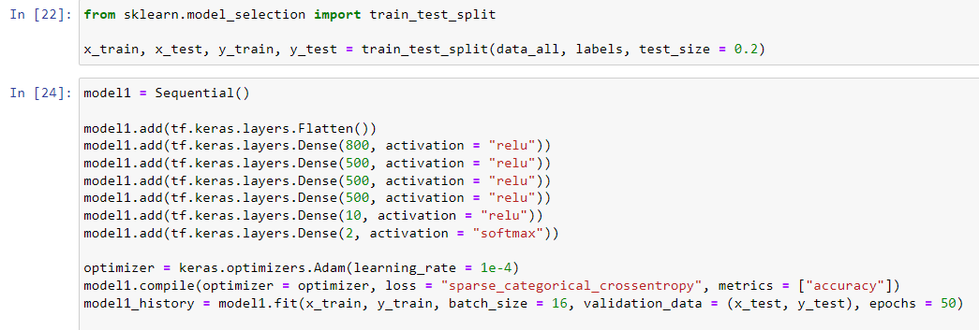
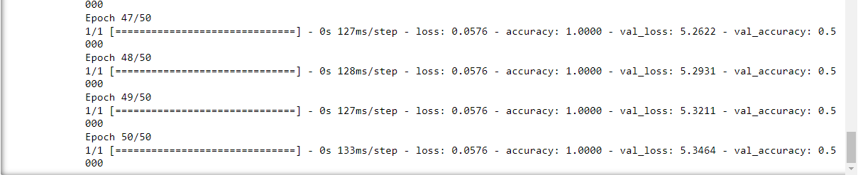
Reconstruction of ANN Model by Separating Test and Training Data

Slide 49
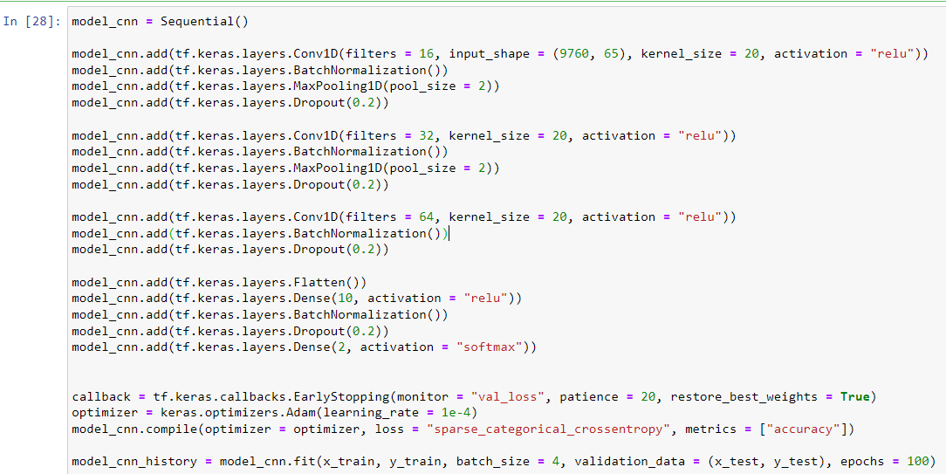
CNN

Slide 50
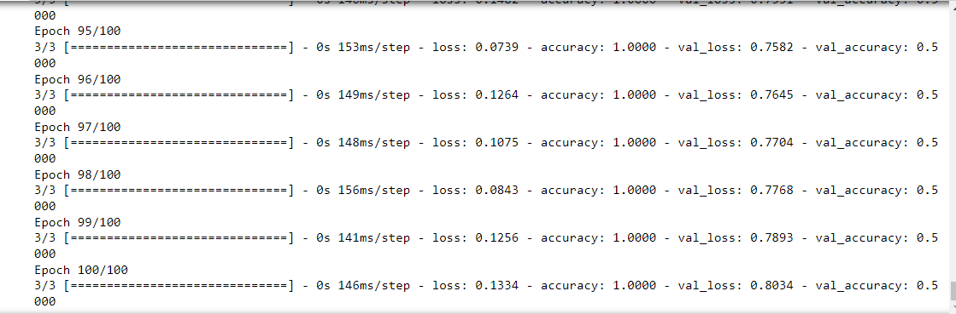
CNN Results

Slide 51
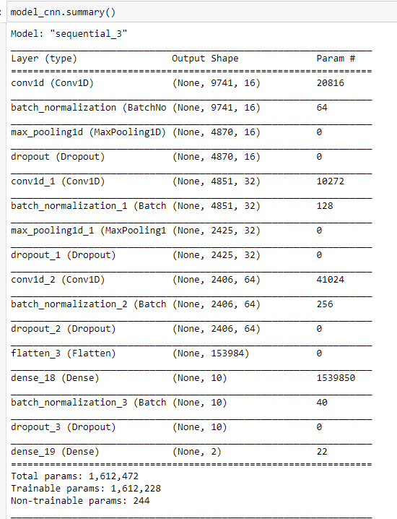
CNN Summary

Slide 52
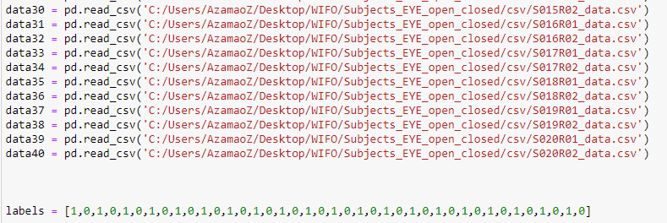
Rebuild models with new parameters

Slide 53
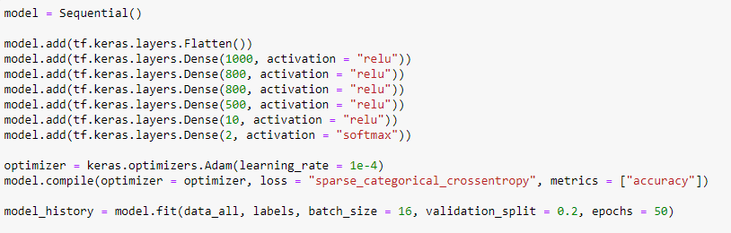
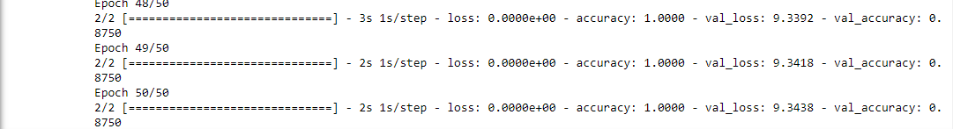
Changing the Hidden-layer Densities in the ANN Model

Slide 54
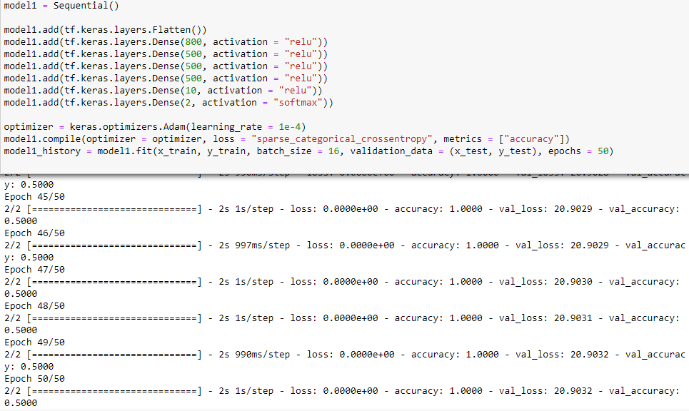
Measuring the Effect of Only the Number of Subjects Without Changing the Hidden-layer Density

Slide 55
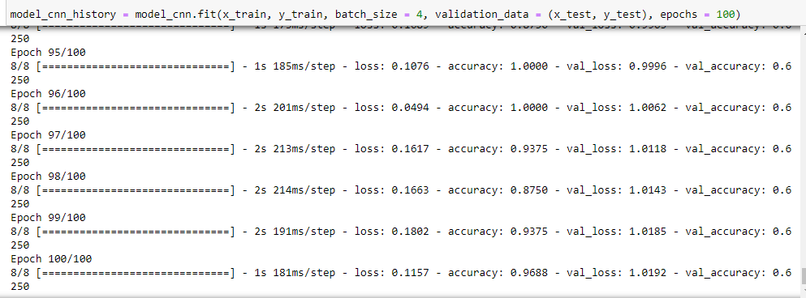
Running the CNN Model with More Data

Slide 56
Conclusion
The performances of the systems under different conditions were examined with the studies.
First of all, for the ANN model, the data is divided as normal, and then the split training and test data are used. When the results were examined, it was seen that the loss of validity decreased significantly. Other results are similar.
The next aim is to compare the ANN and CNN systems for 8 subjects. It was expected that the CNN model would work better on signals. The advantage of the CNN model is that it has a lower validity loss score. Validation remained at 0.5 for the first three models. These results are insufficient for a 2-class problem.
In order to increase the percentage of validation, the number of subjects was increased to 20. In the experiment in which the interlayer density and the separation of the data were compared, it was observed that the success of the ANN model with an increased number of layers increased significantly. Increasing the data without changing the layer density did not cause a significant improvement.

Slide 57
Conclusion
Finally, the CNN model was measured with high data. The model, whose other parameters were not changed, provided higher validation than the original version. However, this level was not as high as the value provided by the ANN model with more middleware. According to the previous findings, it leads to the idea that a more successful classification can be made by changing the density in the Fully Connected (ANN) layer of the CNN model.
Accuracy was achieved as 100% in all models. However, this value indicates over-learning when validation does not reach a significant value. This means that good classification cannot be made for new data.
In addition to these, considering the parameter numbers of the established models, it is seen that CNN models work with much lower parameters. Thus, it can be thought that the use of models established with CNN in BCI systems can be much more advantageous in terms of effort, when sufficient success is achieved.

Slide 58
References
The Introductory Guide to EEG (Electroencephalography) – EMOTIV
A brain–computer interface using electrocorticographic signals in humans - Eric C Leuthardt, Gerwin Schalk, Jonathan R Wolpaw,Jeffrey G Ojemann and Daniel W Moran5
Brain-Computer Interfaces in Medicine - Jerry J. Shih, Dean J. Krusienski and Jonathan R. Wolpawc
Brain–computer interfaces for communication and control - Jonathan R Wolpaw, Niels Birbaumer, Dennis J McFarlanda, Gert Pfurtschellere, Theresa M Vaughana
A Beginner’s Guide to Brain-Computer Interface and Convolutional Neural Networks | by Alexandre Gonfalonieri | Towards Data Science
World’s fastest brain-computer interface: Combining EEG2Code with deep learning - Sebastian Nagel, Martin Spüler
Learning Representations from EEG with Deep Recurrent-Convolutional Neural Networks - Pouya Bashivan, Irina Rish, M. Yeasin, Noel Codella
EDF Tools – Eurochamp Data Center
Transfer Learning Using AlexNet - MATLAB & Simulink (mathworks.com)
A novel approach of decoding EEG four-class motor imagery tasks via scout ESI and CNN - Yimin Hou, Lu Zhou, Shuyue Jia and Xiangmin Lun
A Deep Learning MI-EEG Classication Model for BCIs - Dose, Hauke; Møller, Jakob Skadkær; Puthusserypady, Sadasivan; Iversen, Helle K.
EEGNet: A Compact Convolutional Network for EEG-based Brain-Computer Interfaces - Vernon J. Lawhern, Amelia J. Solon, Nicholas R. Waytowich, Stephen M. Gordon, Chou P. Hung, Brent J. Lance
Temple University EEG Corpus - Downloads (piconepress.com)
A Simplified CNN Classification Method for MI-EEG via the Electrode Pairs Signals - Xiangmin Lun, Zhenglin Yu, Tao Chen, Fang Wang and Yimin Hou
EEG Motor Movement/Imagery Dataset v1.0.0 (physionet.org)
5. Preprocess data - EEGLAB Wiki

